Slide 1
Functions
Slides by Varick and Ashley Erickson
© Varick Erickson

Slide 2
Remember functions from math class?
Functions in C++ have some similarities to the ones you used in Math classes.
Suppose you have the mathematical function
f(x) = x + 3
f(x) is a function
If you input x, the output f(x) will be x + 3.
f(1) = 1 + 3 = 4.
In math, you can also have functions with two variables:
f(x,y) = x + y
If x = 1 and y = 2, we get f(x, y) = 1 + 2 = 3

Slide 3
Functions: Some definitions
Function: a collection of statements to perform a task
Argument: an input to a function
Functions make your life easier and programs easier to write and debug.
Simplifies the process of writing programs
Fewer lines of code to debug
Improves maintainability of programs

Slide 4
Predefined functions
C++ comes with libraries of predefined functions
As long as you include the appropriate #include headers, you can use these functions.
Example: sqrt function
sqrt() returns, or computes, the square root of a number
theRoot = sqrt(9.0);
theRoot will contain 3.0
Requires #include <cmath>
Newer standard libraries, such as cmath, also require
using namespace std;
argument

Slide 5
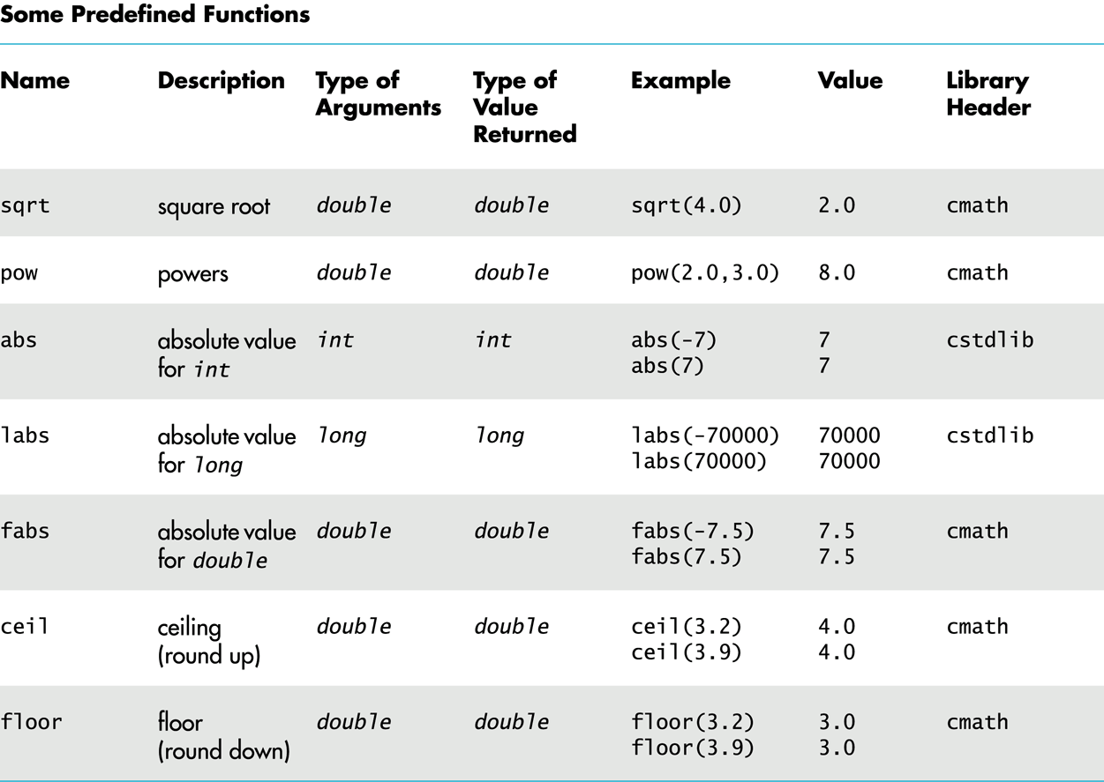
Other predefined functions

Slide 6
Quick caution: the power function
If you need to raise a number to an exponent (such as 2³ = 8), you should use the power function:
double value = pow(2.0, 3.0); // value stores 8
Requires #include <cmath>
WARNING: 2^3 is not the same as 2³. 2^3 is the bitwise XOR between 2 and 3.
2^3 → 10^11 → 01
Notes:
XOR
If the bits are the same, then it is 0
If the bits are different, then it is 1

Slide 7
FYI: (pseudo-)Random Number Generation
How to use the pseudo-random number generator:
Seed the random number generator only once
The rand() function returns a random integer that is greater than or equal to 0 and less than RAND_MAX
#include <cstdlib>
#include <ctime> //ctime library
srand(time(0)); //seed with number of seconds since January 1, 1970

Slide 8
FYI: How to use the pseudo-random number generator
Use % and + to scale to the number range you want
Random number modulo N gives random number between 0 and N – 1.
To get a random number from 1-6 to simulate rolling a six-sided die:
int die = (rand() % 6) + 1;
To get a random number between 0 and 100:
double secretNumber = rand() % 101

Slide 9
Any questions before we move on?
Programmer defined functions

Slide 10
Programmer-defined functions in 3 easy steps!
When you use functions in C++, you will need to do three main things:
1) Declare the function. Use a function declaration (aka function prototype)
2) Define the function. Use a function definition (describes how the function does its task)
3) Call the function. Use a function call (Causes a function to execute.)

Slide 11
1. Declaring a function
Function name
Arguments and data types of the arguments
Return type
double addTogether(double firstNumber, double secondNumber);
// Precondition: firstNumber and secondNumber are initialized.
//Postcondition: returns the sum of firstNumber and secondNumber
Remember semicolon after declaring!
Function declaration: similar to declaring a variable.
tells the compiler about a function.
allows the function to be called before it is defined.

Slide 12
What does declaration include?
Function name
Arguments and data types of the arguments
Return type
double addTogether(double firstNumber, double secondNumber);
// Precondition: firstNumber and secondNumber are initialized.
//Postcondition: returns the sum of firstNumber and secondNumber
Remember semicolon after declaring!
Includes…
name,
how many arguments,
types of the arguments and the
return type (data type of the value the function calculates).
Also tells the formal parameter names (“firstNumber” and “secondNumber”)
Formal parameters are like placeholders for the actual arguments used when the function is called

Slide 13
1. Declaring a function: comments
Function name
Arguments and data types of the arguments
Return type
double addTogether(double firstNumber, double secondNumber);
// Precondition: firstNumber and secondNumber are initialized.
//Postcondition: returns the sum of firstNumber and secondNumber
Remember semicolon after declaring!
Important practice:
It is common practice to have precondition and postcondition as part of the comments of a function.
The precondition and postcondition comments next to each function are needed to explain what each function does.

Slide 14
Additional Declaration things to know
Best practice: Place function declarations/prototypes near top of program, before your main function
Remember that you MUST include precondition and postcondition as comments underneath the function declaration.
You must include either the declaration or full function definition before any call to the function, or your program won’t compile.

Slide 15
Question
What data type does this function return?
int
double
string
it depends on the input
double calcAvg(int firstNum, int secondNum, int thirdNum);
// Precondition: firstNum, secondNum and thirdNum are initialized.
//Postcondition: returns the average of the three inputs.

Slide 16
2. Defining a function
Return type
Function name
Parameter list
NO semicolon!
double addTogether(double firstNumber, double secondNumber)
{
return (firstNumber + secondNumber); //add two arguments
}
Function body
The definition describes how the function does its tasks
The function will execute the code inside the braces of the definition.
Can appear before or after the function is called. In our class, put the definitions after the main() function.
Note: there is NO SEMICOLON after the function definition!

Slide 17
Question
Suppose you used the following arguments in the function addTogether:
double firstNumber = 7;
double secondNumber = 2.5;
int addTogether(double firstNumber, double secondNumber)
{
return (firstNumber + secondNumber); //add two arguments
}
What value would addTogether return when it executes?
A: 7.5
B: 2.0
C: 9.5
D: 9
E: None of these

Slide 18
3. Calling a Function
Example: to call the function addTogether, we use:
addTogether(firstNum, secondNum);
To call a function, use the function name followed by parenthesis, any arguments, and a semicolon (;)
When called, the program executes the body of the called function
Any arguments will be “plugged in” to the definition of the function.
After the function terminates, execution resumes in the calling function at point of call.

Slide 19
Example: calling addTogether
#include <iostream>
using namespace std;
double addTogether(double firstNumber, double secondNumber);
//Precondition: firstNumber and secondNumber are initialized.
//Postcondition: returns the sum of firstNumber and secondNumber
int main() {
double input1 = 0, input2 = 0;
cout << "Enter your first number: ";
cin >> input1;
cout << "Enter your second number: ";
cin >> input2;
cout << "The sum of your numbers is: " << addTogether(input1, input2) << endl;
double avg = addTogether(input1, input2)/2; cout << "The average of your numbers is: " << avg << endl;
return 0;
}
double addTogether(double firstNumber, double secondNumber) {
return (firstNumber + secondNumber); //add two arguments
}

Slide 20
How the flow of control works
#include <iostream>
using namespace std;
double addTogether(double firstNumber, double secondNumber);
//Precondition: firstNumber and secondNumber are initialized.
//Postcondition: returns the sum of firstNumber and secondNumber
int main() {
double input1 = 0, input2 = 0;
cout << "Enter your first number: ";
cin >> input1;
cout << “Enter your second number: ";
cin >> input2;
cout << "The sum of your numbers is: " << addTogether(input1, input2) << endl;
double avg = addTogether(input1, input2)/2; cout << "The average of your numbers is: " << avg << endl;
return 0;
}
double addTogether(double firstNumber, double secondNumber) {
return (firstNumber + secondNumber); //add two arguments
}
Call addTogether
Plug in two inputs into the function
The sum is returned back to the main function

Slide 21
Calling functions: some key terms
Values passed to function are called arguments
Placeholder variables in a function that hold the values passed as arguments are called parameters.
cout << "The sum of your numbers is: " << addTogether(input1, input2) << endl;
double addTogether(double firstNumber, double secondNumber)
{
return (firstNumber + secondNumber); //add two arguments
}

Slide 22
More on Calling Functions
main can call any number of functions
Functions can call other functions or even call themselves (functions calling themselves is called recursion)
Compiler must know the following about a function before it is called:
name
return type
number of parameters
data type of each parameter

Slide 23
Additional Function Call Notes
Functions can have no parameters, one parameter, or multiple parameters
The value of each argument is copied into parameter when the function is called
A parameter’s scope is the function which uses it
Arguments will be promoted/demoted as necessary to match parameters (doubles could be made into int’s if a double is sent into an int parameter).

Slide 24
Questions before we continue?
Next: return statement

Slide 25
About the return statement
Used to end execution of a function
Can be placed anywhere within a function (but statements that follow the return statement will not be executed). Can be used to prevent abnormal execution or return error codes.
The return statement returns the value calculated by the function to the main program (or to the place where the function was called).
Examples: you can return all kinds of things or nothing at all (for void type functions):
return 0;
return subtotal*TAX_RATE;
return;

Slide 26
Function Return Type
If a function returns a value, the type of the value must be indicated:
int main()
If a function does not return a value, its return type is void:
void printHeading()
{
cout << "Monthly Sales\n";
}
Note: in a void function without a return statement, the function ends at its last }

Slide 27
Questions before we continue?
Next: Call by value mechanism

Slide 28
“Call by value” mechanism
Notice how whatever two numbers input1 and input2 we put in addTogether are plugged into the addTogether function.
Input1 became our first function argument
Input2 became our second function argument
This process of plugging in our arguments into the function is called the “call by value” mechanism.
Aka “pass by value” in some books.
cout << "Enter your first number: ";
cin >> input1;
cout << "enter your second number: ";
cin >> input2;
cout << "The sum of your numbers is: " << addTogether(input1, input2) << endl;

Slide 29
Things to know about Call by Value
The values which are plugged in to the formal parameters are the values only and NOT the variables themselves. The variable value is copied to the function. Changes to the parameter in the function do not affect the value of the argument.
The values are plugged in in the order which they are received. The first value is plugged in to the first function parameter, and the second value is plugged into the second parameter, etc.

Slide 30
Four things to know about Call by Value
#include <iostream>
using namespace std;
double addTogether(double firstNumber, double secondNumber);
//Precondition: firstNumber and secondNumber are initialized.
//Postcondition: returns the sum of firstNumber and secondNumber
double addTogether(double firstNumber, double secondNumber, double thirdNumber);
//Precondition: firstNumber, secondNumber, thirdNumber are initialized.
//Postcondition: returns the sum of firstNumber, secondNumber, and thirdNumber
int main()
{
double input1 = 0, input2 = 0;
cout << "Enter your first number: ";
cin >> input1;
cout << "Enter your second number: ";
cin >> input2;
cout << "The sum of your numbers is: " << addTogether(input1, input2) << endl; }
double addTogether(double firstNumber, double secondNumber)
{
return (firstNumber + secondNumber); // add two arguments
}
double addTogether(double firstNumber, double secondNumber, double thirdNumber)
{
return (firstNumber + secondNumber + thirdNumber); // add arguments
}
The number of arguments in the call must match the prototype and definition
The computer uses the arguments to figure out what addTogether definition to use.
(Having multiple functions with the same name but different parameters is called overloading… more on this later)

Slide 31
Example of a bool function
Instead of writing yes/no code each time, consider writing a function. Input the message you want. The function will display your message and ask yes or no.
The function GetYesNo will output whatever prompt message and return a yes/no answer.
bool GetYesNo(string promptMsg)
{
while (true)
{
string ans;
cout << promptMsg << « (y/n) ";
cin >> ans;
if (ans == "y" || ans == "yes")
{
return true;
}
else if (ans == "n" || ans == "no")
{
return false;
}
else
{
cout << "Please answer y or n" << endl;
}
}
}

Slide 32
Example of bool function usage
while (!GetYesNo("Are you enjoying this loop? ")) { cout << "Let's ask that question again..." << endl; } cout << "I'm glad you enjoyed it!" << endl;
while (true) { playGame(); if (!GetYesNo("Would you like to play again? ")) break; } cout << “Thanks for playing!" << endl;

Slide 33
Overloading
Overloading a function name means providing more than one declaration and definition using the same function name
Very convenient for situations in which the “same” function is needed for different numbers or types of arguments
Example: Having an “average” function which can accept two or three arguments, or different data types.

Slide 34
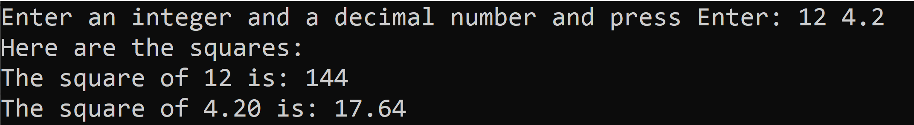
Sample overloading program
#include <iostream>
#include <iomanip>
using namespace std;
//declare the functions
//overloaded functions have same name but different parameter lists
int square(int number);
//Precondition: number is initialized to an int value
//Postcondition: returns the value of number squared as an int
double square(double number);
//Precondition: number is initialized to a double value
//Postcondition: returns the value of number squared as a double
int main()
{
int userInt;
double userDouble;
//Get an int and a double number from user.
cout << fixed << showpoint << setprecision(2);
cout << "Enter an integer and a decimal number and press Enter: ";
cin >> userInt >> userDouble;
//Display the squares of the numbers
cout << "Here are the squares: \n"
<< "The square of " << userInt << " is: " << square(userInt);
cout << "\nThe square of " << userDouble << " is: " << square(userDouble);
return 0;
}
//define the functions
int square(int number)
{
return number * number;
}
double square(double number)
{
return number * number;
}
Notice that both “flavors” of the square function have their own declaration and definition. The compiler determines which one to use based on the input arguments.

Slide 35
Overload with caution!
Overloading can be used to create functions that perform the same task but take different parameter types or different number of parameters
Caution: Overloading requires extra care when defining the functions. Avoid using unless it improves your program’s readability.
Notice that we need to include separate declarations and definitions for each version of the overloaded function.
The Compiler will determine which version of function to call by argument and parameter lists

Slide 36
Any questions before we move on?
Next topic: calling by reference

Slide 37
Remember our call by value rules?
The values which are plugged in to the formal parameters are the values only and NOT the variables themselves. The variable value is copied to the function. Changes to the parameter in the function do not affect the value of the argument.
The values are plugged in in the order which they are received. The first value is plugged in to the first function parameter, and the second value is plugged into the second parameter, etc.
If you plug in a value for a function parameter, that value is plugged in for all instances of the parameter within the function.

Slide 38
Pass by reference / Call by reference
If we want to actually change the values of the variables in memory (rather than copies) we need to use a different approach called “call by reference” or “pass by reference”
Call by reference aka Pass by reference allows a function to modify the original argument from the function call, not a copy of the argument
Allows the function to modify its arguments
Provides a way for the function to ‘return’ more than one value

Slide 39
How to pass/call by reference
You DO have to include an ampersand (&) next to the variables in the function declaration
2. You don’t include the ampersand when calling the function
3. You DO need to include the ampersand next to the variables in the function definition
Space between type and & is unimportant
//declare the function doubleNum
void doubleNum(int& refVar);
doubleNum(number);
//define doubleNum
void doubleNum(int& refVar)
{
refVar *= 2; //double the value of refVar
}
Space between type and & is unimportant

Slide 40
Example/Demo: Passing by reference
#include <iostream>
using namespace std;
//declare the function doubleNum
void doubleNum(int& refVar);
//Precondition: refVar is initialized to a whole number
//Postcondition: doubles the value of refVar using pass by reference.
//declare the main function
int main()
{
int number;
cout << "Enter a number that you want to double:";
cin >> number;
cout << "In the main function, our number is: " << number << endl;
cout << "Now calling doubleNum..." << endl;
doubleNum(number);
cout << "Our number in the main function is now: "
<< number << endl
<< "Amazing! It doubled!!!" << endl;
return 0;
}
//define doubleNum
void doubleNum(int& refVar)
{
refVar *= 2; //double the value of refVar
}
The & here in the declaration indicates that the parameter is a reference variable.
Here we are calling doubleNum and passing by reference
You also must put an & in the definition

Slide 41
Reference Variable Notes
Each reference parameter in your functions must contain & otherwise it will be treated as pass by value
Space between data type and & is unimportant
Must use & in the function definition and declaration. The ampersand & designates the variable or parameter as a reference variable.
All arguments passed to reference parameter must be variables – cannot be an expression or constant

Slide 42
Additional things to note
Use when appropriate – don’t use when argument should not be changed by function, or if function needs to return only 1 value
Call-by-value and call-by-reference parameters can be mixed in the same function
void goodStuff(int& par1, int par2, double& par3);

Slide 43
How do you decide when to call by reference?
Does the function need to change the value of the variable used as an argument?
Is the thing you are passing very large in size and not something you want to have to copy?
Yes? Use a call-by-reference parameter
No? Use a call-by-value parameter

Slide 44
Any questions before we move on?
Next topic: functions calling functions

Slide 45
Functions calling functions
A function body may contain a call to another function
The called function declaration must still appear before it is called
Functions cannot be defined in the body of another function (other languages may allow this but C++ does not)

Slide 46
Example: Ordering Integers
//having one function call another
#include <iostream>
using namespace std;
void getInput(int& input1, int& input2);
//read two integers from the keyboard
void swapValues(int& variable1, int& variable2);
//interchanges the values of variable1 and variable2
void order(int& n1, int& n2);
//orders the numbers in the variables n1 and n2
void giveResults(int output1, int output2);
//outputs the values in output1 and output 2
//assumes that output 1 <= output2
int main()
{
int firstNum, secondNum;
getInput(firstNum, secondNum);
order(firstNum, secondNum);
giveResults(firstNum, secondNum);
return 0;
}
//define functions
void getInput(int& input1, int& input2)
{
cout << "Enter two integers separated by a space, then press Enter: ";
cin >> input1 >> input2;
}
void swapValues(int& variable1, int& variable2)
{
int temp;
temp = variable1;
variable1 = variable2;
variable2 = temp;
}
void order(int& n1, int& n2)
{
if (n1 > n2)
swapValues(n1, n2);
}
void giveResults(int output1, int output2)
{
cout << "In increasing order the numbers are: "
<< output1 << " " << output2 << endl;
}

Slide 47
Notice: call by reference in swapValues
Call by reference allows us to swap the values
void swapValues(int& variable1, int& variable2);
// Precondition: variable1 and variable 2 have been given values
// Postcondition: the values of variable1 and variable 2 are interchanged

